Slide 1
"
Detecting Biases in Newspapers using
Natural Language Processing
Submitted By:
Syeda Jannatul Ferdous [20301067]
Purobi Paromita [20301214]
Puspita Das [20301246]
Sabbir Bin Abdul Latif [23341056]
Submitted To:
Annajiat Alim Rasel
Senior Lecturer, Department of CSE
BRAC University
Section: 01
Group: 12
RA: Adib Muhammad Amit
ST: Farah Binta Haque

Slide 2
Unbiased news
is so important
Why
What is media bias.
Importance of unbiased news in society.
Introduction to NLP as a solution.
"

Slide 3
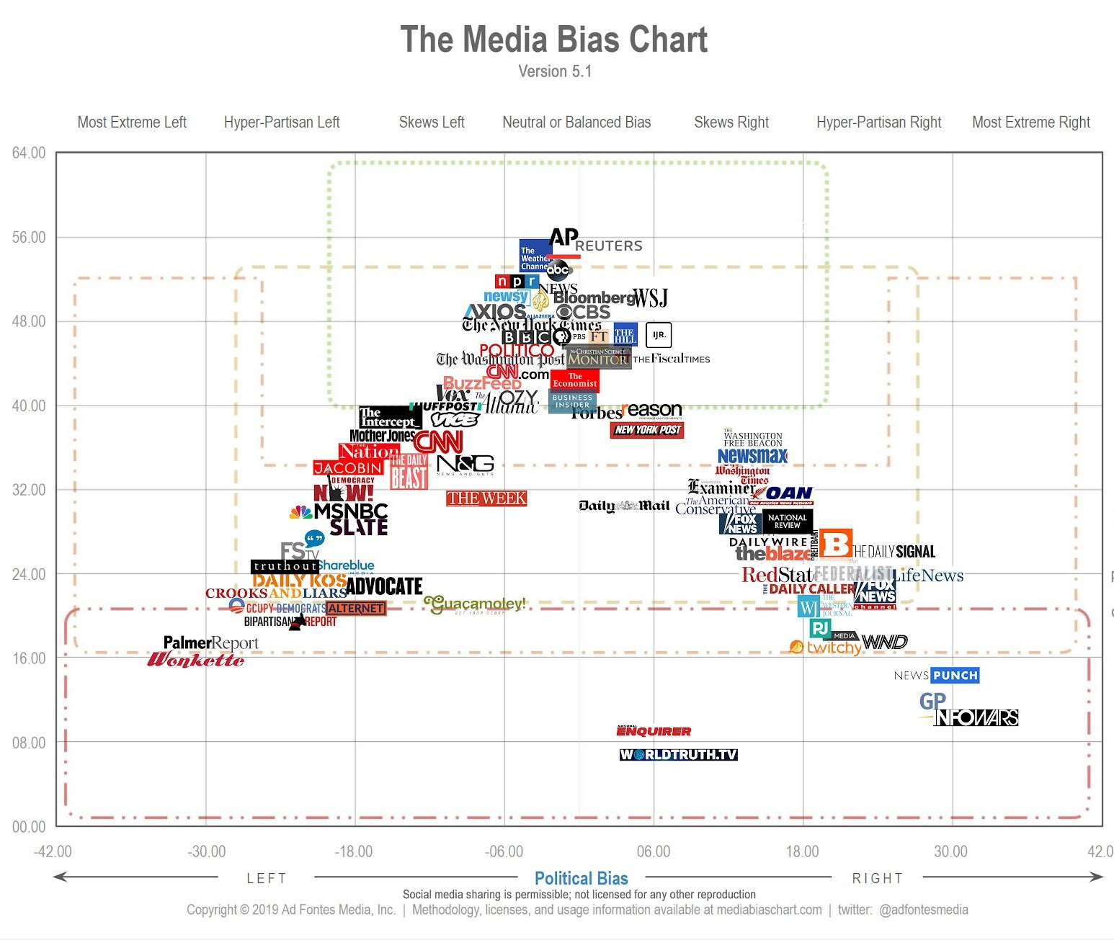
Literature Survey on Media Bias and NLP
Quantitative measure in legislative speeches of bias (Groseclose and Milyo, 2005).
Linguistic characteristics of news articles to measure media bias (Gentzkow and Shapiro, 2010).
Sentiment analysis and text classifications.
Gaps

Slide 4
Project Concept and Methodology
Collecting Dataset
Preprocessing
Sentiment analysis
Text Classification
TF-IDF Vectorization
Model Training and Testing
Evaluation Metrics
Analyzing Results

Slide 5
Motivation
Use in media watchdogs
Safe journalism
To mitigate media biases and creating a healthy and democratic society where false news will no longer exists.
Journalists can employ our model as a check for unintentional biases in their work while reporting
"

Slide 6
Conclusion and Next Steps
01
02
03
04
Summary of importance
Challenges and Solutions
Limitations
Future research directions

Slide 7
THANKS
"

